Slide 1

Human Computer Interaction
Chapter four
“Interaction”

Slide 2
The Interaction
interaction models
translations between user and system
ergonomics
physical characteristics of interaction
interaction styles
the nature of user/system dialog
context
social, organizational, motivational

Slide 3
What is interaction?
communication
user system

Slide 4
Some terms of interaction
domain – defines an area of expertise and knowledge in
some real-world activity.
e.g. graphic design
task – how you go about doing it. – operations to manipulate the concepts of a domain. e.g. … select fill tool, click over triangle
goal – the desired output from a performed task.
– what you want to achieve.
e.g. create a solid red triangle
intention - is a specific action required to meet the goal.
Note - user and the system do not use the same terms to describe the domain and goals.

Slide 5
Donald Norman’s model
The interactive cycle can be divided into two major phases: execution and evaluation. These can then be subdivided into further stages, seven in all.
Seven stages
Establishing the goal.
Forming the intention.
Specifying the action sequence.
Executing the action.
Perceiving the system state.
Interpreting the system state.
Evaluating the system state with respect to the goals and intentions.
Norman’s model concentrates on user’s view of the interface. It does not deal with the system’s communication through the interface.

Slide 6
execution/evaluation loop
goal
user establishes the goal
formulates intention
specifies actions at interface
executes action
perceives system state
interprets system state
evaluates system state with respect to goal
execution
evaluation
system

Slide 7
execution/evaluation loop
goal
user establishes the goal
formulates intention
specifies actions at interface
executes action
perceives system state
interprets system state
evaluates system state with respect to goal
execution
evaluation
system

Slide 8
execution/evaluation loop
goal
user establishes the goal
formulates intention
specifies actions at interface
executes action
perceives system state
interprets system state
evaluates system state with respect to goal
execution
evaluation
system

Slide 9
execution/evaluation loop
goal
user establishes the goal
formulates intention
specifies actions at interface
executes action
perceives system state
interprets system state
evaluates system state with respect to goal
execution
evaluation
system

Slide 10
Using Norman’s model
Some systems are harder to use than others
Gulf of Execution
Deference between the users formalization of the actions and the actions allowed by the system.
Gulf of Evaluation
Deference between the physical presentation of the system state and the expectation of the user.

Slide 11

Human error - slips and mistakes
slip
understand system and goal
correct formulation of action
incorrect action
mistake
may not even have right goal!
Fixing things?
slip – better interface design
mistake – better understanding of system

Slide 12
Abowd and Beale framework
extension of Norman…
their interaction framework has 4 parts
user
input
system
output
each has its own unique language interaction ⇒ translation between languages
problems in interaction = problems in translation
O
output
S
core
U
task
I
input

Slide 13
Using Abowd & Beale’s model
user intentions → translated into actions at the interface → translated into alterations of system state → reflected in the output display → interpreted by the user
general framework for understanding interaction
not restricted to electronic computer systems
identifies all major components involved in interaction
allows comparative assessment of systems
an abstraction

Slide 14
Ergonomics
Study of the physical characteristics of interaction
Also known as human factors – but this can also be used to mean much of HCI!
Ergonomics good at defining standards and guidelines for constraining the way we design certain aspects of systems.

Slide 15
Ergonomics - examples
arrangement of controls and displays
e.g. controls grouped according to function or frequency of use, or sequentially
surrounding environment
e.g. seating arrangements adaptable to cope with all sizes of user
health issues
e.g. physical position, environmental conditions (temperature, humidity), lighting, noise,
use of colour
e.g. use of red for warning, green for okay, awareness of colour-blindness etc.

Slide 16
Industrial interfaces
Office interface vs. industrial interface?
Context matters!
office industrial
type of data textual numeric
rate of change slow fast
environment clean dirty

Slide 17
Glass interfaces ?
industrial interface:
traditional … dials and knobs
now … screens and keypads
glass interface
cheaper, more flexible, multiple representations, precise values
not physically located, loss of context, complex interfaces
may need both
Vessel B Temp
0
100
200
113
multiple representations of same information

Slide 18
Indirect manipulation
office– direct manipulation
user interacts with artificial world
system
industrial – indirect manipulation
user interacts with real world through interface
issues ..
feedback
delays
interface
plant
immediate
feedback
instruments

Slide 19
interaction styles
dialogue … computer and user
distinct styles of interaction

Slide 20
Common interaction styles
command line interface
menus
natural language
question/answer and query dialogue
form-fills and spreadsheets
WIMP
point and click
three–dimensional interfaces

Slide 21
Command line interface
Way of expressing instructions to the computer directly
function keys, single characters, short abbreviations, whole words, or a combination
suitable for repetitive tasks
better for expert users than novices
offers direct access to system functionality
command names/abbreviations should be meaningful!
Typical example: the Unix system

Slide 22
Menus
Set of options displayed on the screen
Options visible
less recall - easier to use
rely on recognition so names should be meaningful
Selection by:
numbers, letters, arrow keys, mouse
combination (e.g. mouse plus accelerators)
Often options hierarchically grouped
sensible grouping is needed
Restricted form of full WIMP system

Slide 23
Natural language
Familiar to user
speech recognition or typed natural language
Problems
vague
ambiguous
hard to do well!
Solutions
try to understand a subset
pick on key words

Slide 24
Query interfaces
Question/answer interfaces
user led through interaction via series of questions
suitable for novice users but restricted functionality
often used in information systems
Query languages (e.g. SQL)
used to retrieve information from database
requires understanding of database structure and language syntax, hence requires some expertise

Slide 25
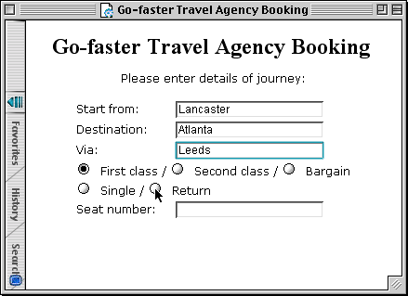
Form-fills
Primarily for data entry or data retrieval
Screen like paper form.
Data put in relevant place
Requires
good design
obvious correction facilities

Slide 26
Spreadsheets
first spreadsheet VISICALC, followed by Lotus 1-2-3 MS Excel most common today
sophisticated variation of form-filling.
grid of cells contain a value or a formula
formula can involve values of other cells e.g. sum of all cells in this column
user can enter and alter data spreadsheet maintains consistency

Slide 27
WIMP Interface
Windows
Icons
Menus
Pointers
… or windows, icons, mice, and pull-down menus!
default style for majority of interactive computer systems, especially PCs and desktop machines

Slide 28
Point and click interfaces
used in ..
multimedia
web browsers
hypertext
just click something!
icons, text links or location on map
minimal typing

Slide 29


Three dimensional interfaces
virtual reality
‘ordinary’ window systems
highlighting
visual affordance
indiscriminate use just confusing!
3D workspaces
use for extra virtual space
light and occlusion give depth
distance effects
flat buttons …
click me!
… or sculptured

Slide 30
elements of the WIMP interface
windows, icons, menus, pointers
buttons, toolbars, palettes, dialog boxes

Slide 31
Windows
Areas of the screen that behave as if they were independent
can contain text or graphics
can be moved or resized
can overlap and obscure each other, or can be laid out next to one another (tiled)
scrollbars
allow the user to move the contents of the window up and down or from side to side
title bars
describe the name of the window

Slide 32
Icons
small picture or image
represents some object in the interface
often a window or action
windows can be closed down (iconized)
small representation of many accessible windows
icons can be many and various
highly stylized
realistic representations.

Slide 33
Pointers
important component
WIMP style relies on pointing and selecting things
uses mouse, trackpad, joystick, trackball, cursor keys or keyboard shortcuts
wide variety of graphical images

Slide 34
Menus
Choice of operations or services offered on the screen
Required option selected with pointer
problem – take a lot of screen space
solution – pop-up: menu appears when needed

Slide 35
Kinds of Menus
Menu Bar at top of screen (normally), menu drags down
pull-down menu - mouse hold and drag down menu
drop-down menu - mouse click reveals menu
fall-down menus - mouse just moves over bar!
Contextual menu appears where you are
pop-up menus - actions for selected object
pie menus - arranged in a circle
easier to select item (larger target area)
quicker (same distance to any option) … but not widely used!

Slide 36
Menus extras
Cascading menus
hierarchical menu structure
menu selection opens new menu
and so in and infinitum
Keyboard accelerators
key combinations - same effect as menu item
two kinds
active when menu open – usually first letter
active when menu closed – usually Ctrl + letter
usually different !!!

Slide 37
Menus design issues
which kind to use?
what to include in menus at all?
words to use (action or description)
how to group items?
choice of keyboard accelerators

Slide 38
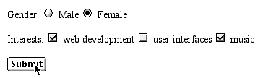
Buttons
individual and isolated regions within a display that can be selected to invoke an action
Special kinds
radio buttons – set of mutually exclusive choices
check boxes – set of non-exclusive choices

Slide 39
Toolbars
long lines of icons … … but what do they do?
fast access to common actions
often customizable:
choose which toolbars to see
choose what options are on it

Slide 40
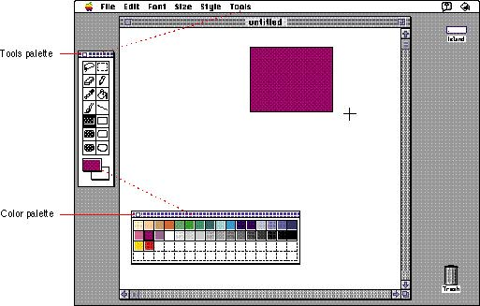
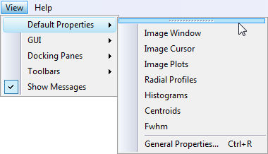
Palettes and tear-off menus
Problem menu not there when you want it
Solution palettes – little windows of actions
shown/hidden via menu option e.g. available shapes in drawing package
tear-off and pin-up menus
menu ‘tears off’ to become palette

Slide 41
Dialogue boxes
information windows that pop up to inform of an important event or request information.
e.g: when saving a file, a dialogue box is displayed to allow the user to specify the filename and location. Once the file is saved, the box disappears.

Slide 42
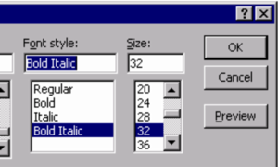
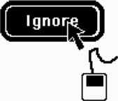
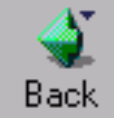
understanding and choosing widgets
widgets - bits that make the GUI
what do they do?
what are they good for?

Slide 43
widgets?
individual items on a GUI screen ...
checkboxes, menus, toolbars, buttons etc.
three aspects:
appearance - what they look like
interaction - how they behave
semantics - what they mean

Slide 44
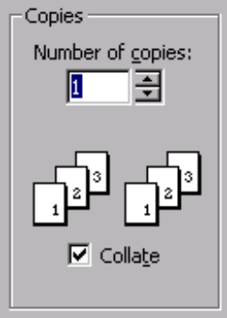
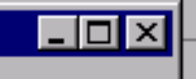

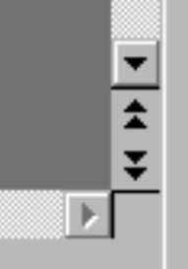


appearance

Slide 45
appearance includes words
verbs - action words
quit, exit, embolden, italicise
adjectives - description/state words
bold, italic
nouns - usually as a form of description
Times New Roman, US Letter
beware of mixes …
embolden + italic !!?!

Slide 46

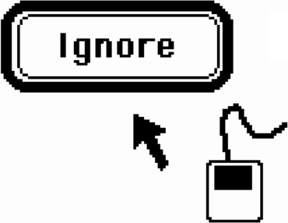
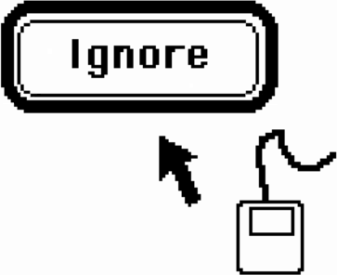
behavior
Move mouse over button – highlights
Move mouse off target with button still down – highlight removed
Release mouse – nothing happens

Slide 47
behavior … ctd.
some bits the toolkit does for you
but is it right?
some you control
e.g. drawing, interactions between widgets
beware timing issues
e.g. large selections under Windows apps.

Slide 48
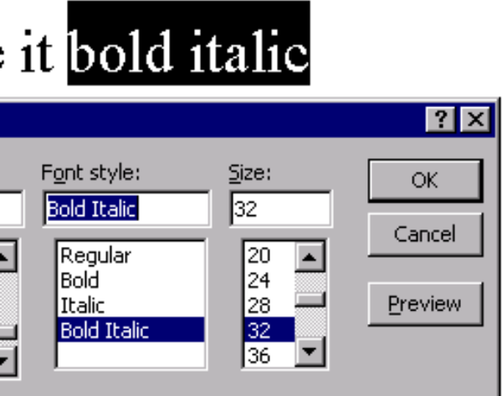
semantics
menus, buttons, …, etc.
do things …
… lets make it bold italic

Slide 49
YOU say what it means
semantics usually up to you
although widgets may link direct to database
even then, you say what links
think separately:
meaning first - what you want it to do
then appearance - how you do it
choose the widget for the job

Slide 50
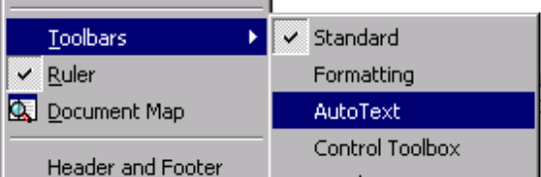
what do you want?
actions
usually menu, buttons, or toolbar
setting state/options
usually checkbox, radio button, combi-box
but …
menus can be used to set state etc. ...

Slide 51

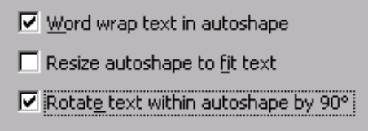
how many?
one of several options
radio buttons, selection menu
zero, one or more options
checkbox, multi-choice menu

Slide 52
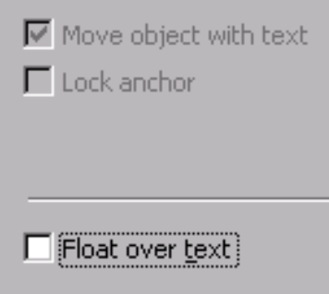
and more ...
number
fixed e.g. bold, italic, underline
variable e.g. font list
scolling through telephone list …
liveness
grey out inactive options
dynamic interactions
some choices dependent on others

Slide 53
interactivity
easy to focus on look
what about feel?

Slide 54
Speech–driven interfaces
rapidly improving … … but still inaccurate
how to have robust dialogue? … interaction of course!
e.g. airline reservation: reliable “yes” and “no” + system reflects back its understanding “you want a ticket from New York to Boston?”

Slide 55
Look and … feel
WIMP systems have the same elements: windows, icons., menus, pointers, buttons, etc.
but different window systems … behave differently
e.g. MacOS vs Windows menus
appearance + behaviour = look and feel

Slide 56
Initiative
who has the initiative? old question–answer – computer WIMP interface – user
WIMP exceptions … pre-emptive parts of the interface
modal dialog boxes
come and won’t go away!
good for errors, essential steps
but use with care

Slide 57
Error and repair
can’t always avoid errors … … but we can put them right
make it easy to detect errors … then the user can repair them
hello, this is the Go Faster booking system
what would you like?
(user) I want to fly from New York to London
you want a ticket from New York to Boston
(user) no
sorry, please confirm one at a time
do you want to fly from New York
(user) yes
… … …

Slide 58
Physical design
many constraints:
ergonomic – minimum button size
physical – high-voltage switches are big
legal and safety – high cooker controls
context and environment – easy to clean
aesthetic – must look good
economic – … and not cost too much!

Slide 59
paradigms

Slide 60
why study paradigms
Concerns
how can an interactive system be developed to ensure its usability?
how can the usability of an interactive system be demonstrated or measured?
History of interactive system design provides paradigms for usable designs

Slide 61
What are Paradigms
Predominant theoretical frameworks or scientific world views
e.g., Aristotelian, Newtonian, Einsteinian (relativistic) paradigms in physics
Understanding HCI history is largely about understanding a series of paradigm shifts
Not all listed here are necessarily “paradigm” shifts, but are at least candidates
History will judge which are true shifts
A paradigm is a standard, perspective, or set of ideas.

Slide 62
Paradigms of interaction
New computing technologies arrive, creating a new perception of the human—computer relationship.
We can trace some of these shifts in the history of interactive technologies.

Slide 63
The initial paradigm
Batch processing
Impersonal computing

Slide 64
Example Paradigm Shifts
Batch processing
Time-sharing
Interactive computing

Slide 65
Example Paradigm Shifts
Batch processing
Timesharing
Networking
@#$% !
???
Community computing

Slide 66
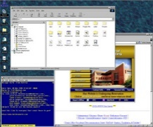
Example Paradigm Shifts
Batch processing
Timesharing
Networking
Graphical displays
Move this file here,
and copy this to there.
C…P… filename
dot star… or was
it R…M?
% foo.bar
ABORT
dumby!!!
Direct manipulation

Slide 67
Example Paradigm Shifts
Batch processing
Timesharing
Networking
Graphical display
Microprocessor
Personal computing

Slide 68
Example Paradigm Shifts
Batch processing
Timesharing
Networking
Graphical display
Microprocessor
WWW
Global information

Slide 69
Example Paradigm Shifts
Batch processing
Timesharing
Networking
Graphical display
Microprocessor
WWW
Ubiquitous Computing
A symbiosis of physical and electronic worlds in service of everyday activities.

Slide 70
Time-sharing
Time sharing means that a single computer could support multiple users.
The introduction of time sharing meant the end of batch-processing, in which complete jobs processed individually.

Slide 71
Video Display Units
The earliest applications of display screen images were developed in military applications.
However, it took until 1962 to develop Sketchpad, a simulation language for visual models.
It demonstrated that computers could be used to create visual models of abstractions.

Slide 72
Programming toolkits
The idea of building components of a computer system that will allow you to rebuild a more complex system is called bootstrapping.

Slide 73
Cont..
The power of programming toolkits is that small, well understood components can be composed in fixed ways in order to create larger tools.
Once these larger tools become understood, they can continue to be composed with other tools, and the process continues.

Slide 74
Personal computing
1970s – Papert's LOGO language for simple graphics programming by children
A system is more powerful as it becomes easier to user
Future of computing in small, powerful machines dedicated to the individual
Kay at Xerox PARC – the Dynabook as the ultimate personal computer

Slide 75
Window systems and the WIMP interface
humans can pursue more than one task at a time
windows used for dialogue partitioning, to “change the topic”
1981 – Xerox Star first commercial windowing system
windows, icons, menus and pointers now familiar interaction mechanisms

Slide 76
Metaphor
Metaphors are used quite successful to teach new concepts in terms of ones which are already understood.
This also works with computers: many of the tasks on a computer are presented a metaphors of tasks in an office environment.
However, the metaphor is inadequate for promoting (and even gets in line with) a full understanding of the computer.

Slide 77
Direct manipulation
1982 – Shneiderman describes appeal of graphically-based interaction
visibility of objects
incremental action and rapid feedback
reversibility encourages exploration
syntactic correctness of all actions
replace language with action
1984 – Apple Macintosh
the model-world metaphor
What You See Is What You Get (WYSIWYG)

Slide 78
Language versus Action
actions do not always speak louder than words!
DM – interface replaces underlying system
language paradigm
interface as mediator
interface acts as intelligent agent
programming by example is both action and language

Slide 79
Hypertext
1945 – Vannevar Bush and the memex
key to success in managing explosion of information
mid 1960s – Nelson describes hypertext as non-linear browsing structure
hypermedia and multimedia
Nelson's Xanadu project still a dream today

Slide 80
Multimodality
a mode is a human communication channel
emphasis on simultaneous use of multiple channels for input and output

Slide 81
Computer Supported Cooperative Work (CSCW)
CSCW removes bias of single user / single computer system
Can no longer neglect the social aspects
Electronic mail is most prominent success

Slide 82
The World Wide Web
Hypertext, as originally realized, was a closed system
Simple, universal protocols (e.g. HTTP) and mark-up languages (e.g. HTML) made publishing and accessing easy
Critical mass of users lead to a complete transformation of our information economy.

Slide 83
Agent-based Interfaces
Original interfaces
Commands given to computer
Language-based
Direct Manipulation/WIMP
Commands performed on “world” representation
Action based
Agents - return to language by instilling proactivity and “intelligence” in command processor
Avatars, natural language processing

Slide 84
Ubiquitous Computing
“The most profound technologies are those that disappear.”
Mark Weiser, 1991
Late 1980’s: computer was very apparent
How to make it disappear?
Shrink and embed/distribute it in the physical world
Design interactions that don’t demand our intention

Slide 85
Sensor-based and Context-aware Interaction
Humans are good at recognizing the “context” of a situation and reacting appropriately
Automatically sensing physical phenomena (e.g., light, temp, location, identity) becoming easier
How can we go from sensed physical measures to interactions that behave as if made “aware” of the surroundings?

